Slide 1


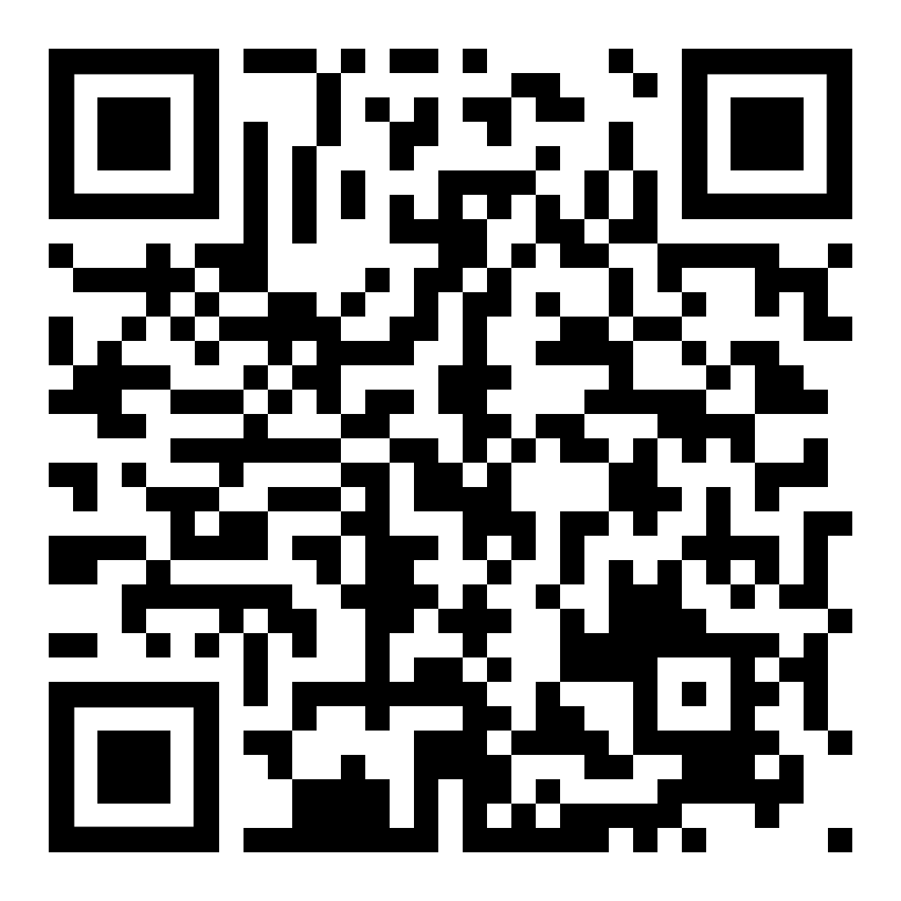
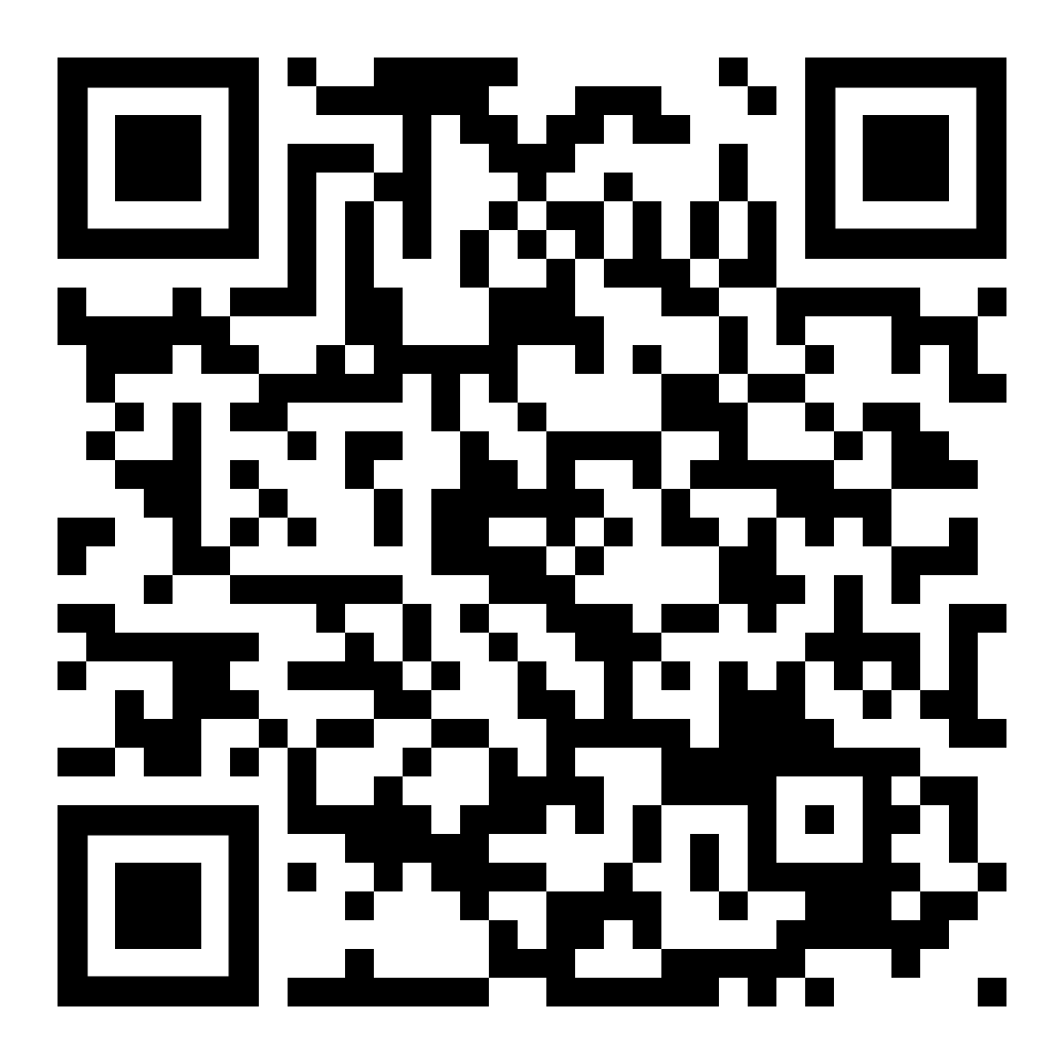
RECOVERY is recruiting patients hospitalised with either:
Influenza with evidence of pneumonia, or
Presumed bacterial community-acquired pneumonia (CAP)
Are you looking after a patient with influenza or CAP?
Might they be eligible for RECOVERY?
If so, please contact the trial team and help us improve the treatment of these conditions!
ELIGIBILITY
1. Hospitalised (planned overnight stay) with a pneumonia syndrome, defined as
  a) typical symptoms of new respiratory infection, and
  b) objective evidence of acute lung disease (e.g. compatible CXR, CT or US, clinical exam, or new hypoxia), and
  c) alternative causes considered unlikely (e.g. heart failure)
2. Trial treatment is not considered definitely indicated or contraindicated by the responsible clinician
3. One of the following diagnoses:
Confirmed influenza A or B
Three treatment comparisons are open. Patients may enter one, two, or all three, depending on eligibility
(each is an independent 1:1 randomisation)
Diagnosis of CAP with planned antibiotic treatment
(without suspected SARS-CoV-2, influenza,
active pulmonary tuberculosis or PCP)
One treatment comparison is open (1:1 randomisation)
OR
Oseltamivir (antiviral)
OR
usual care without oseltamivir*
Baloxavir (antiviral) OR
usual care without baloxavir
Dexamethasone (6 mg od) OR
usual care without systemic corticosteroids
[to be eligible, patients must be hypoxic without suspected SARS-COV-2 coinfection]
Dexamethasone (6 mg od)
OR
usual care without systemic corticosteroids
To refer potential patients, or for questions, contact the trial team:
Email [local research team email]
If urgent tel [local team tel]
Principal Investigator:
[local PI]
Associate PIs:
[names API(s), if any]
For more information on each treatment comparison
see the Intervention Sheets here ->
*Oseltamivir is recommended for many hospitalised patients in UKHSA guidelines, but the Department of Health encourages inclusion of patients into trials of oseltamivir. Patients are only eligible for this comparison if their responsible clinician would be happy to follow either possible allocation.
“[…] there remains both clinical and collective uncertainty (equipoise) about the role of antiviral and steroid treatments for most patients hospitalised with influenza. […] Whilst it is appropriate for those not taking part in national trials to continue to follow existing national guidance, the trials will strengthen the evidence base that underpins that guidance.” Letter supporting influenza trials from Chris Whitty, CMO for England (full letter via QR link on the left)
For protocol, training materials, and DHSC letters supporting influenza trials see here ->
Trial website: www.recoverytrial.net

