Slide 1
The RECOVERY trial
EU Influenza Treatment Training
V1.0 2024-01-24

Slide 2
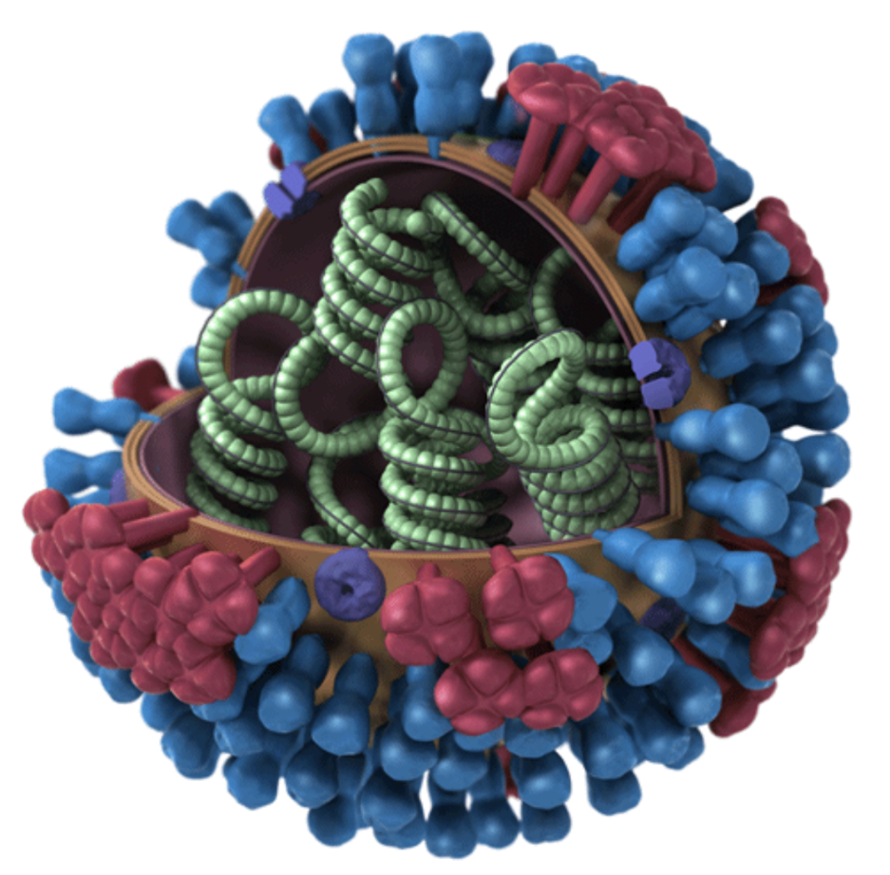
Influenza Background
Seasonal influenza kills ~400,000 people/year worldwide (one third aged under 65)
An influenza pandemic has the potential to kill tens of millions
RECOVERY & other trials quickly identified life-saving treatments for COVID-19 by randomising thousands of patients
Many other promising treatments were found to be ineffective
Unlike COVID-19, we do not have good (i.e. randomised) evidence to guide influenza treatment

Slide 3
RECOVERY Eligibility
Hospitalised patients aged ≥18 years
Pneumonia syndrome, e.g.
Typical symptoms of a new respiratory tract infection (cough, shortness of breath, fever, etc); and
Objective evidence of acute lung disease (e.g. X-ray/CT/US changes, hypoxia, or clinical exam); and
Alternative causes considered unlikely or excluded (e.g. heart failure)
However, the diagnosis is a clinical one in the opinion of the managing doctor (these criteria are a guide)
One of the following diagnoses:
Confirmed SARS-CoV-2 infection (COVID-19 comparisons not open in EU)
Confirmed influenza A or B infection
Community-acquired pneumonia with planned antibiotics (without suspected COVID-19/flu/PCP/TB)
No medical history that might put the patient at risk if they were to participate
Attending clinician does not believe a specific trial treatment is indicated or contra-indicated

Slide 4
RECOVERY design: Core Protocol V27.0 (includes non-EU comparisons)
HOSPITALISED PATIENTS WITH PNEUMONIA
COVID-19 high dose corticosteroid comparison (patients on NIV or IMV)
Community-acquired pneumonia (CAP) corticosteroid comparison
ANALYSIS
Sotrovimab comparison
E
High dose dexamethasone
Usual care (standard dose corticosteroids)
J
Sotrovimab
Usual care without sotrovimab
M
Dexamethasone
Usual care without corticosteroids
or
or
or
Patients with confirmed SARS-CoV-2 (NOT OPEN IN EU)
Patients with CAP (without suspected SARS-CoV-2/influenza/PCP/TB)
R
Outcomes at 28 days and 6 months
Mortality
Time to discharge alive
Progression to ventilation or death
Baseline data collected, suitability determined
1:1 randomisation in each suitable comparison
Baloxavir comparison
NOT CURRENTLY OPEN IN EU
Influenza corticosteroid comparison (patients with hypoxia)
Oseltamivir comparison
G
Baloxavir
Usual care without baloxavir
H
Oseltamivir
Usual care without oseltamivir
I
Dexamethasone
Usual care without corticosteroids
or
or
or
Patients with confirmed INFLUENZA

Slide 5
RECOVERY design:
EU influenza comparisons
HOSPITALISED PATIENTS WITH PNEUMONIA
COVID-19 high dose corticosteroid comparison (patients on NIV or IMV)
Community-acquired pneumonia (CAP) corticosteroid comparison
ANALYSIS
Sotrovimab comparison
E
High dose dexamethasone
Usual care (standard dose corticosteroids)
J
Sotrovimab
Usual care without sotrovimab
M
Dexamethasone
Usual care without corticosteroids
or
or
or
Patients with confirmed SARS-CoV-2 (NOT OPEN IN EU)
Patients with CAP (without suspected SARS-CoV-2/influenza/PCP/TB)
R
Outcomes at 28 days and 6 months
Mortality
Time to discharge alive
Progression to ventilation or death
Baseline data collected, suitability determined
1:1 randomisation in each suitable comparison
Baloxavir comparison
NOT CURRENTLY OPEN IN EU
Influenza corticosteroid comparison (patients with hypoxia)
Oseltamivir comparison
G
Baloxavir
Usual care without baloxavir
H
Oseltamivir
Usual care without oseltamivir
I
Dexamethasone
Usual care without corticosteroids
or
or
or
Patients with confirmed INFLUENZA

Slide 6
Oseltamivir (TAMIFLU)

Slide 7
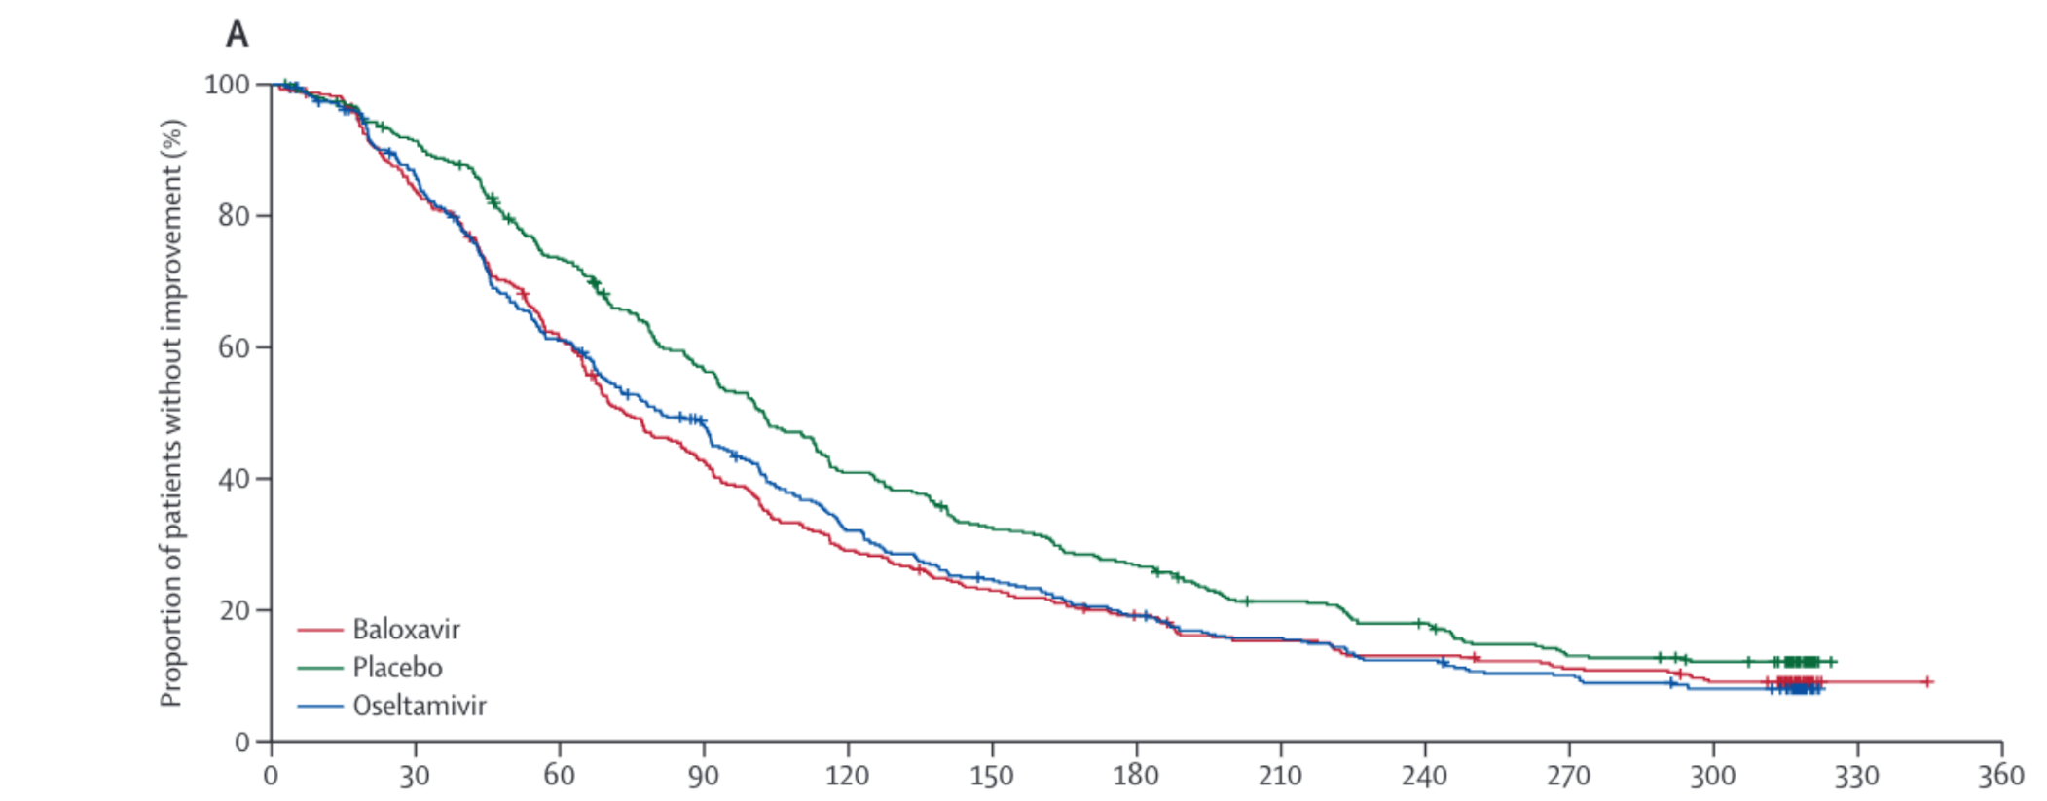
Oseltamivir (Tamiflu) Background
Oseltamivir is a neuraminidase inhibitor (NAI)
Neuraminidase allows the budding of virus from infected cells, so NAIs interfere with the viral replication cycle
Oseltamivir reduces the duration of flu symptoms by ~16 hours if started within 48 hours of symptom onset
% with no symptom improvement
Baloxavir
Placebo
Oseltamivir
Ison MG et al. Lancet Infect Dis. 2020 Oct;20(10):1204-1214. PMID32526195
Time since start of treatment (h)

Slide 8
Oseltamivir (Tamiflu) Background
Some observational studies have suggested a benefit of oseltamivir in hospitalised patients, but others have not, and evidence from randomised trials is lacking.^{1,2}
Such observational data is prone to biases that cannot be reliably avoided
During the pandemic, observational data for several COVID-19 treatments (e.g. azithromycin, convalescent plasma) was misleading, and contradicted by subsequent large randomised trials
Without randomised evidence, the efficacy and safety of oseltamivir in hospitalised patients is uncertain
1 Muthuri SG, et al. Lancet Respir Med. 2014 May;2(5):395-404. PMC6637757
2 Heneghan CJ, et al. Health Technol Assess. 2016 May;20(42):1-242. PMC4904189

Slide 9
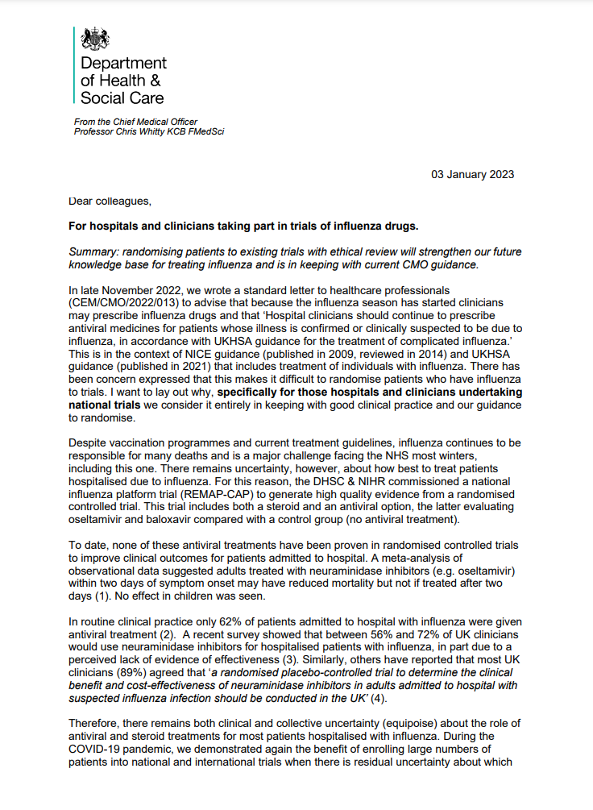
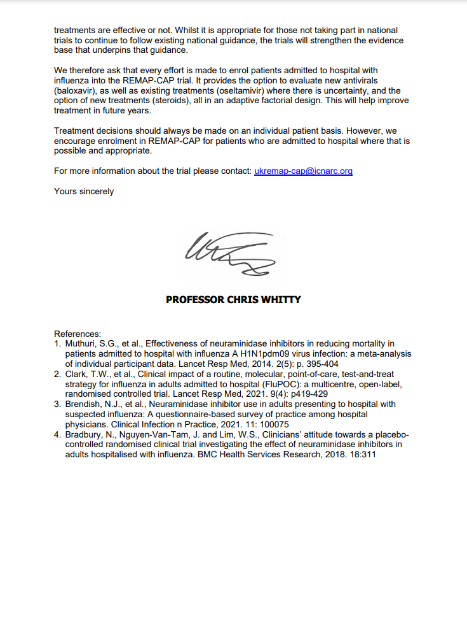
Oseltamivir (Tamiflu) Background
Many treatment guidelines recommend NAIs for patients hospitalised with influenza
In 2023, the Chief Medical Officer for England wrote to all UK hospitals in support of trials that include a no antiviral arm
“[...] specifically for those hospitals and clinicians undertaking national trials we consider it entirely in keeping with good clinical practice and our guidance to randomise.”
“To date, none of these antiviral treatments have been proven in randomised controlled trials to improve clinical outcomes for patients admitted to hospital.”
Local discussions/communication may be needed to explain this context

Slide 10
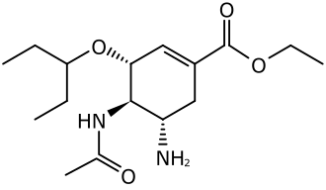
Oseltamivir (Tamiflu) Eligibility
Patients with recent or planned use of an NAI for the current infection are ineligible (oseltamivir or zanamivir)
Patients treated for bacterial co-infection are eligible if the clinical team think influenza may be contributing to the lung disease
Pregnant & breastfeeding women are eligible (see protocol appendix 4 for procedure)
Can be used in patients with liver & renal failure

Slide 11
Oseltamivir (Tamiflu) Dosing and side effects
Oral or nasogastric only (no iv route)
Treat for 5 days (10 days if immunocompromised) to be completed at home if discharged
Dose: 75mg twice daily with normal renal function
75mg once daily if eGFR 10-29ml/min
75mg as a single dose if eGFR <10ml/min (or on dialysis/haemofiltration)
Adjustment needed if weight <40kg (see protocol)
Note renal dose adjustment in RECOVERY differs from SmPC
No significant drug interactions known
Commonest side effects are headache, nausea and vomiting (<10%), serious hypersensitivity reactions have been rarely reported

Slide 12
CORTICOSTEROIDS FOR INFLUENZA

Slide 13
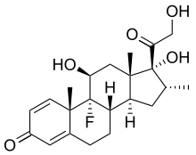
Corticosteroids for influenza Background
Corticosteroids are standard treatment for patients with COVID-19 pneumonia, reducing risk of death by ~1/5 in patients on oxygen
Previously proposed as a treatment for influenza pneumonia but never been properly tested in hospitalised patients
Reducing immune-mediated lung damage may improve survival in severe flu as it does in COVID-19

Slide 14
Corticosteroids for influenza
Eligibility
Open to patients with influenza pneumonia plus hypoxia (supplemental oxygen or SpO2 <92% on air)
Contraindicated if current or planned use of systemic corticosteroids, or if coinfected with SARS-CoV-2
Pregnant & breastfeeding women eligible (but use prednisolone/hydrocortisone instead of dexamethasone – see protocol)
Patients with liver or renal failure are eligible
If, after randomisation, corticosteroids become indicated in a patient allocated usual care they should be given (this should only happen because of a change in clinical condition)

Slide 15
Corticosteroids for influenza
Dosing and side effects
Dexamethasone 6mg once daily, oral/nasogastric or iv
Treat for 10 days or until discharged, whichever is sooner
No baseline or follow-up samples
Important side effects of corticosteroids should be considered and anticipated as in normal practice, e.g.
Risk of hyperglycaemia (consider need for increased monitoring)
Peptic ulceration (consider need for gastroprotection if high risk)
Infection (especially if other reasons for immunosuppression)
Psychiatric reactions
Fluid retention
Risk of adrenal insufficiency with sudden withdrawal in some patients, e.g. significant previous corticosteroid use, or other reasons for adrenal insufficiency (consider gradual withdrawal following normal practice)

Slide 16
Corticosteroids for influenza Potential interactions
Dexamethasone is a CYP3A4 substrate, so there is a risk of increased exposure and side effects if given alongside potent CYP3A4 inhibitors, e.g.
Clarithromycin/erythromycin (but not azithromycin)
Ritonavir/cobicistat
Azole antifungals
Consider whether a potent CYP3A4 inhibitor could safely be suspended/replaced, or if increased monitoring for steroid side effects is needed
If potent CYP3A4 inhibitor cannot be avoided then it may not be appropriate to enrol the patient in the corticosteroid comparison, but this is not prohibited by the protocol, as management should be based on an assessment of individual risks/benefits

Slide 17
Summary - Influenza Treatments
Influenza kills hundreds of thousands of people per year, and an influenza pandemic could be a hundred-fold worse
Unlike COVID-19, no promising flu treatments have been properly assessed in randomised trials of hospitalised patients
Thank you for joining us to improve the treatment of influenza!

