Slide 1
Randomised Evaluation of COVID-19 Therapy: the RECOVERY trial
Local Site Training Material

Slide 2
Background
A novel coronavirus-induced disease was identified in Wuhan, China (COVID-19)
In January 2020 the Chinese CDC identified the causal agent as a new betacoronavirus (SARS coronavirus 2 or SARS-CoV-2)
Symptoms vary from none to severe pneumonia in a minority
It is estimated that in the UK 50 million people may be infected, of whom 5% may need admission and of these 30% might need level 3 (ICU) care
The progression from prodrome to severe disease takes 1-2 weeks, offering a therapeutic window
Currently there are no proven therapies for COVID-19

Slide 3
RECOVERY trial design
No additional treatment
ELIGIBLE PATIENTS
Age ≥18 years
Admitted to hospital
Proven or suspected SARS-CoV-2 infection
OUTCOMES
Primary: all-cause death
Secondary:
Duration of hospitalisation
Need for ventilation
Need for renal replacement therapy
Lopinavir-ritonavir
400/100 mg bd PO for 10 days
R
Dexamethasone
6 mg od PO/IV for 10 days
Hydroxychloroquine
See protocol for dosing
Azithromycin
500 mg od PO/IV for 10 days

Slide 4
Study treatments: Lopinavir-Ritonavir
Licensed for treatment of HIV
Lopinavir is a protease inhibitor (combined with ritonavir to increase lopinavir’s plasma half-life)
Shown to have in vitro activity against SARS and MERS viruses
Contraindications: severe hepatic insufficiency; co-administration with other drugs dependent on CYP3A metabolism
(Alfuzosin, ranolazine, amiodarone, dronaderone, fusidic acid, neratinib, venetoclax, colchicine, astemizole, terfenadine, lurasidone, pimozide, quetiapine, dihydroergotamine, ergonovine, ergotamine, methylergonovine, cisapride, elbasvir/grazoprevir, ombitasvir/paritaprevir/ritonavir, lovastatin, simvastatin, lomitapide, avanafil, sildenafil, vardenafil, midazolam, triazolam.)
Side-effects: diarrhoea, nausea and vomiting

Slide 5
Study treatments: Dexamethasone
Modulates immune system which may be beneficial in context of severe pneumonia with superimposed ARDS
Contraindications: none
Side-effects: hyperglycaemia, mood/sleep disturbance, hypernatraemia

Slide 6
Study treatments: Hydroxychloroquine
Anti-malarial drug which has in vitro activity against SARS viruses
Contraindications: long QT syndrome.
Macrolide antibiotics and quinolones should be prescribed with care as they also prolong the QT interval
Side-effects: QT interval prolongation (but arrhythmias rare), itchy skin (especially in dark-skinned patients), headache

Slide 7
Study treatments: Azithromycin
Commonly used antibiotic (“macrolide”) with antiviral and immunomodulatory properties
Contraindications: long QT syndrome, allergy to macrolide antibiotics
Side-effects: QT interval prolongation, interaction with other drugs (ciclosporin, digoxin)

Slide 8
Randomisation
If a study treatment is contraindicated in a given patient, then they can still be randomised
Randomisation will allocate them to one of the other treatments
Randomisation is ‘simple’ (i.e. no stratification or minimisation)
Randomisation ratio is 2 (standard care):1:1:1

Slide 9
Identification and invitation
All adult patients with proven or suspected SARS-CoV-2 infection admitted should be considered for trial
Should be discussed with senior member of clinical team and assuming
All eligibility criteria are met; and
No medical history that might, in the opinion of the attending clinician, put the patient at significant risk if he/she were to participate in the trial, the patient should be offered participation
All documents available on trial website: www.recoverytrial.net

Slide 10
Informed consent
Patient should be provided with Participant Information Sheet (2 pages) and allowed to read and ask any questions

Slide 11
Informed consent
Key points:
Ensure the patient has had time to ask any questions (they will be scared).
Participation is voluntary and they must understand that (and that if they do not enter the trial they still receive the best care currently available).
All treatments have side-effects and they will be monitored for these.
Some of their data will be shared with the trial team outside the hospital (and possibly government officials who might check the trial is being done properly). Anyone who sees their data is bound by strict confidentiality rules.
Their data will be stored on a computer for several years, but will be kept secure. The trial may collect data held about them from other sources (eg, routinely collected data in the NHS) for up to 10 years.
These are all listed on the consent form itself, so use this as your guide.

Slide 12
Informed consent
If they are willing then they should write their name, sign and date consent page
Person receiving consent should do the same and write the hospital and patient name at the top
Make copies (or scan):
1 for participant
1 for site file (e-mail to local PI)
1 for medical notes (or scan into EHR)

Slide 13
Informed consent
If participant can give consent but is unable to sign then a witness may complete form on top of page 2
Person receiving consent should complete their section
Make copies (or scan):
1 for participant
1 for site file (e-mail to local PI)
1 for medical notes (or scan into EHR)

Slide 14
Informed consent
Some patients will be too ill to give informed consent
In this situation, provide Participant Information Sheet to legal representative (e.g. close relative, friend or doctor not involved in trial)
They complete form on bottom of page 2
Person receiving consent should complete their section
Make copies (or scan):
1 for participant
1 for site file (e-mail to local PI)
1 for medical notes (or scan into EHR)

Slide 15
Randomisation
Randomisation does not have to be done by the person who took consent
Randomisation must be done online and can be accessed via the trial website: www.recoverytrial.net
Follow links for “Randomisation”
You will be able to download a Participant Information Sheet/Consent Form here too in case you need it

Slide 16
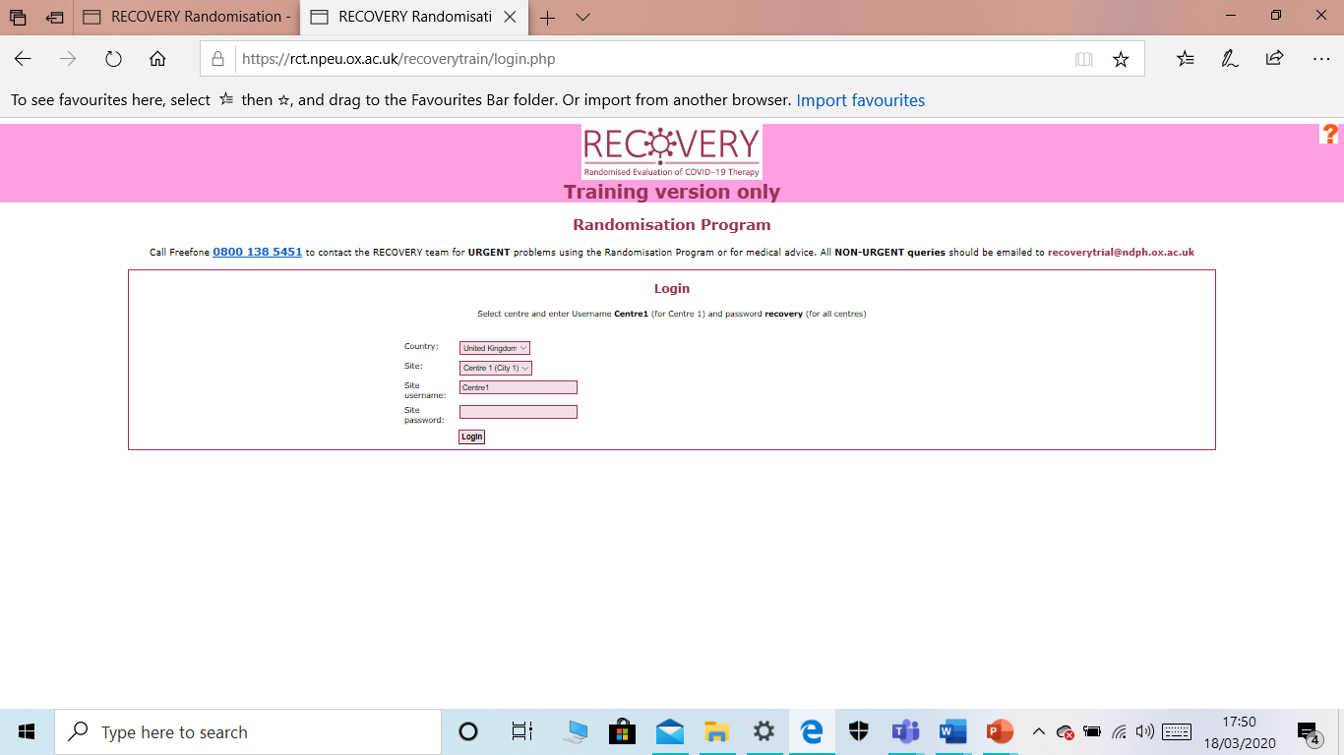
Randomisation
Select your site from the second dropdown list and enter the username and password for your hospital in the password box
Click “Login”

Slide 17
Randomisation
Click on “Enrol patient into study”

Slide 18
Randomisation
Complete the fields shown
Scroll down the page

Slide 19
Randomisation
Complete the fields shown
Scroll down the page

Slide 20
Randomisation
Complete the fields shown
Questions A15.1-3 refer to availability in your hospital (it may be your pharmacy does not have them all)
Please enter your name and an e-mail address at which you can be contacted in case of questions
Then press ‘Continue’

Slide 21
Randomisation
Review the data you have entered.
If you need to correct anything, click ‘Amend’
If you wish to abandon, click ‘Cancel’
Otherwise, click ‘Randomise’

Slide 22
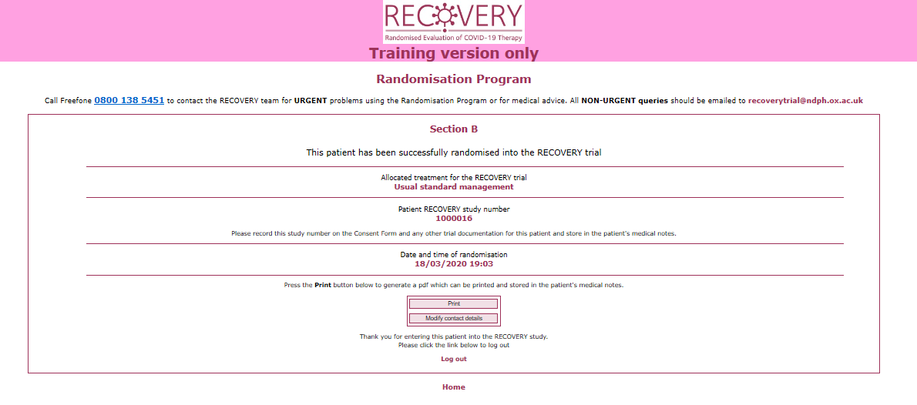
Randomisation
Make a note of the allocation and ensure that it is prescribed on the participant’s drug chart
Record the study number in the medical record and on the consent form if available

Slide 23
Problems
If you have any questions about the process or run into problems with the website please do one of the following:
Review our Frequently Asked Questions on the study website www.recoverytrial.net
E-mail the study team at recoverytrial@ndph.ox.ac.uk
Telephone the study team (24/7) on 0800 1385451 (urgent calls only please)

Slide 24
Problems
If you have any questions about the process or run into problems with the website please do one of the following:
Review our Frequently Asked Questions on the study website www.recoverytrial.net
E-mail the study team at recoverytrial@ndph.ox.ac.uk
Telephone the study team (24/7) on 0800 1385451 (urgent calls only please)

