Slide 1

Randomised Evaluation of COVID-19 Therapy: the RECOVERY trial
Obtaining informed consent
Local Site Training Material
V2.0 05-Nov-2021

Slide 2
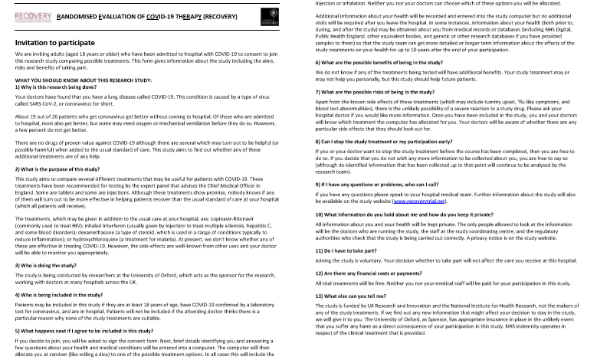
Informed consent
Patient should be provided with Participant Information Sheet and allowed to read and ask any questions

Slide 3
Informed consent
Key points:
  Ensure the patient has had time to ask any questions (they will be scared).
  Participation is voluntary and they must understand that (and that if they do not enter the trial they still receive the best care currently available).
  All treatments have side-effects and they will be monitored for these.
  Some of their data will be shared with the trial team outside the hospital (and possibly government officials who might check the trial is being done properly). Anyone who sees their data is bound by strict confidentiality rules.
  Their data will be stored on a computer for several years and will be kept secure. The trial may collect data about them from other sources (e.g. routinely collected data in the NHS) for up to 10 years.
These are all listed on the consent form itself, so use this as your guide.

Slide 4
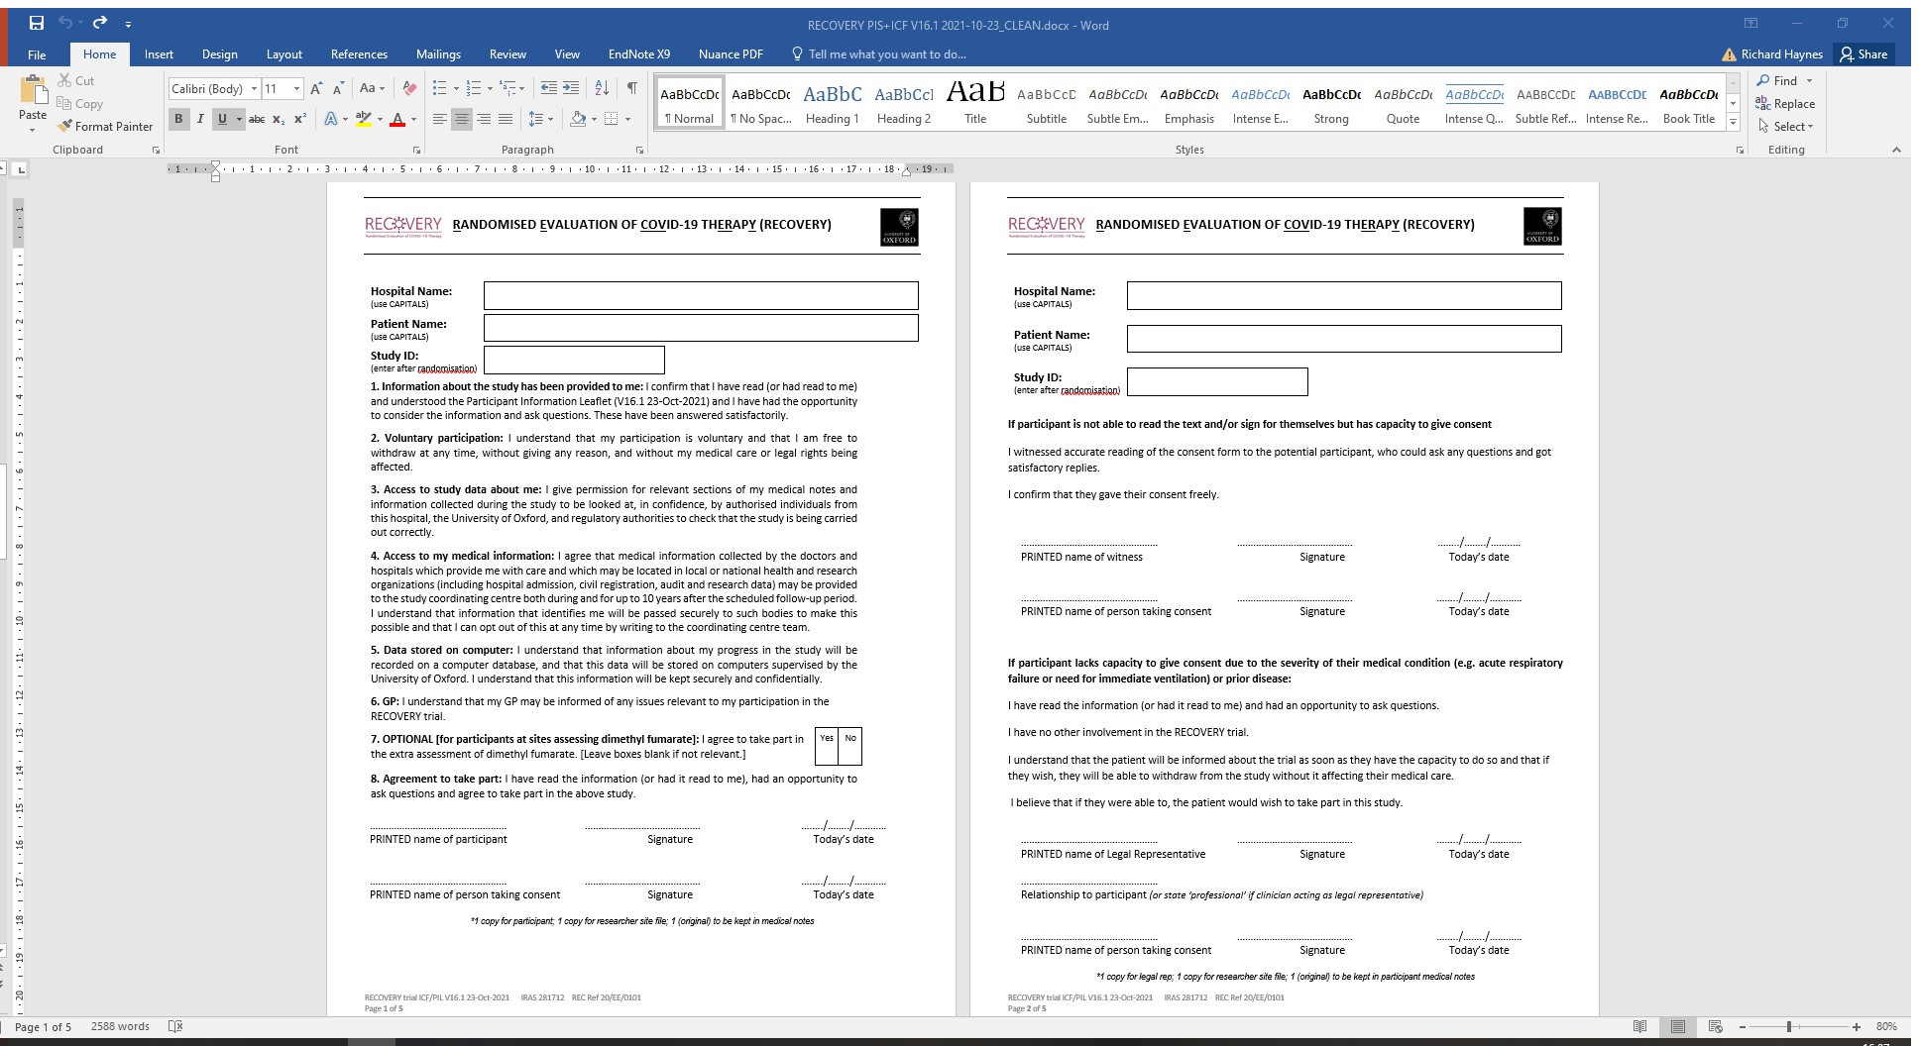
Informed consent: personal
If they are willing and able then they should write their name, sign and date consent page
Person taking consent should do the
same and write the hospital and patient name
at the top
Make copies (or scan):
  1 for participant
  1 for site file (e-mail to local PI)
  1 for medical notes (or scan into EHR)
Completed
by person
TAKING
consent
Completed
by person
GIVING
consent

Slide 5
Informed consent – other languages
RECOVERY website includes PIS/ICF in Bengali, French, Polish, Portugese, Punjabi, Urdu and Welsh
If consenter does not also speak the language, process should be supported by impartial (i.e. not a member of research team) translator, which could be telephone translation service
Please document in the notes carefully how consent was obtained in such situations

Slide 6
Informed consent: witnessed
If participant can give consent (i.e. has capacity) but is unable to sign then a witness should complete upper section on page 2
Witness should be ‘impartial’ i.e. not a member of the research team
Person taking consent should complete their section
Make copies (or scan):
  1 for participant
  1 for site file (e-mail to local PI)
  1 for medical notes (or scan into EHR)
Completed
by person
TAKING
consent
Completed
by person
WITNESSING
consent

Slide 7
Informed consent: legal representative
Some patients will be too ill to give informed consent, or lack capacity for another reason
In this situation, provide Participant Information Sheet to legal representative. This person may be
  close relative or friend (personal legal representative)
  independent doctor (professional legal representative)
They complete the lower section of page 2, including their relationship to participant
Person taking consent should complete their section
Make copies (or scan):
  1 for participant
  1 for site file (e-mail to local PI)
  1 for medical notes (or scan into EHR)
Completed
by person
TAKING
consent
Completed
by person
GIVING
consent

Slide 8
Informed consent: legal representative
Personal legal representatives (relatives or friends) must be available in person to complete their section of consent form, this cannot be done over the telephone
  If not available in person, use a professional legal representative who can speak to friends and family of patient to understand their likely wishes
Professional legal representatives must be ‘independent’
  Must not connected with conduct of the trial (for this patient or any other) i.e. not involved in eligibility decisions, obtaining consent from other patients with capacity
  May be doctor primarily responsible for the patient or another person nominated by the trust/health board
  Can complete this training (and background training) to inform their decisions
  Ideally hospitals will have a group of such individuals who are prepared to act in this role

Slide 9
Informed consent: legal representative
If participant regains capacity prior to discharge, they should be provided with written information about the trial, in particular their rights and how to exercise them
  PIS is ideal
  This should be documented in the medical notes (and ideally their discharge letter)
In the UK, they do not need to complete a consent form themselves, but this may be necessary in other countries

Slide 10
Informed consent:
Summary
Consent can be given in several ways in RECOVERY:
  By patient themselves (directly, or using a witness if necessary)
  By legal representative, if they lack capacity
    May be personal or professional
Professional legal representatives must be independent of the trial
  Ideally, sites will have a team of staff willing to act in this role
  If patients regain capacity, they must be informed of their participation including providing written materials so they know how to exercise their rights
Thank you for help with this vital aspect of RECOVERY

